Slide 1

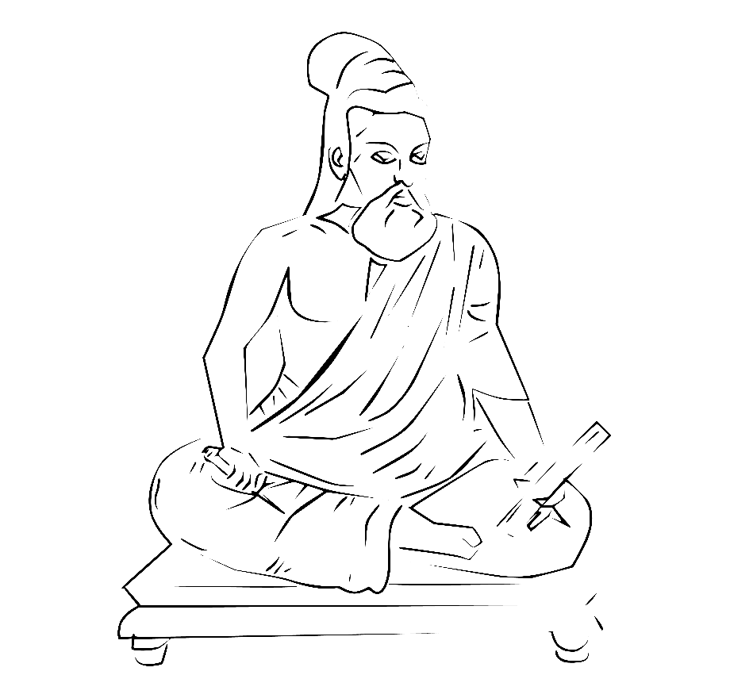





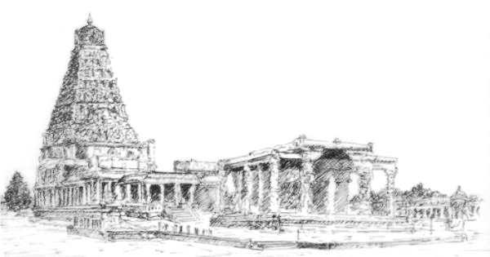
Drop. Trigger. Classify.
Event-Driven AI on Azure
Adilakshmi Vadavalli, PhD
Solution Architect | Capgemini
Notes:
~1 min. Quick self-intro as the MC hands over — your name/role are already on screen.

Slide 2

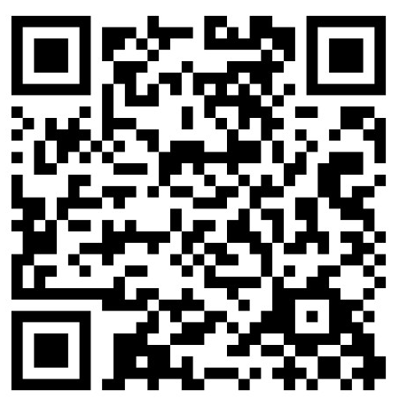
ABOUT THE SPEAKER
Adilakshmi Vadavalli, PhD
Solution Architect | AWS & Azure Specialist | Capgemini
Extensive experience across data science, cloud solution architecture, and enterprise AI delivery.
AWS & Azure specialist, designing production-grade ML and GenAI systems for global clients.
Focus areas: MLOps, Generative AI, and Agentic AI systems — from prototypes to production.
Regularly engages with academia through industry expert sessions, FDPs, and developer community connects
Let’s Connect on LinkedIn
Scan the QR code to view my profile, projects, and future sessions.
Notes:
~1.5 min. Walk through the bullets briefly; point out the QR code at the end for anyone who wants to connect after.

Slide 3
SESSION AGENDA
What We’ll Cover Today
01
Business Use Case
The manual-review bottleneck, the impact of automating it, and the real challenges we hit building it
02
Architecture
Upload, event trigger, vision classification, and storage — how the pipeline works end to end
03
Live demo/recording
Watching an outlet photo move through the pipeline, live or via a recorded run
04
Scaling & Agentic AI
What breaks at higher volume, the evolved architecture, and what to plan for with Microsoft’s agent framework
Notes:
~1 min. Preview the four sections — note that the last one may be a recording as a live-demo fallback.

Slide 4


01 · BUSINESS USE CASE
Verifying Every Outlet Photo, One at a Time
The Ask
The Bottleneck
● Field teams photograph shops as proof when an outlet is created or audited
● Every photo must be confirmed as a genuine shop image before the record is trusted
● Submission volume runs into the thousands of outlets, continuously
● Manual review runs at roughly one image per minute
● Judgment varies from one reviewer to the next
● Backlogs delay outlet onboarding and audit sign-off
● Doesn’t scale as the field network keeps growing
Notes:
~2.5 min. Set up the real-world pain point: manual review doesn't scale. Keep 'The Ask' and 'The Bottleneck' brief and let the bullets do the work.

Slide 5



01 · BUSINESS USE CASE
Automation Changes the Math
Figures below are from a real production deployment of this pattern in the retail sector.
100ms
~95%
97%
9,600+
to classify one photo
model accuracy
outlets verified
real-world success rate
manual review: ~1 per minute
training & validation
in production
in live deployment
Notes:
~2 min. Let the big numbers land — pause after '100ms vs ~1/min' before moving on.

Slide 6
01 · BUSINESS USE CASE
Challenges We Hit, and What We Learned
CHALLENGE
LESSON LEARNT
Only a few hundred labeled examples to work with
→
Pretrained vision models cut the need for large custom training sets
1
Far more “Shop” examples than “Not-Shop” ones
→
Track precision and recall per class — overall accuracy hides the gap
2
Blurry, low-light, or low-resolution photos
→
Gate image quality before the model call, not after
3
Inconsistent geotag formats coming from the field
→
Normalize and validate metadata at ingestion, not downstream
4
Edge cases that still needed a human eye
→
Design the human-in-the-loop path in from day one
5
Notes:
~3 min. This is the credibility slide — real lessons from building the first version. Rows 3 and 5 foreshadow the Pre-Checks step and Human Review branch coming up.

Slide 7
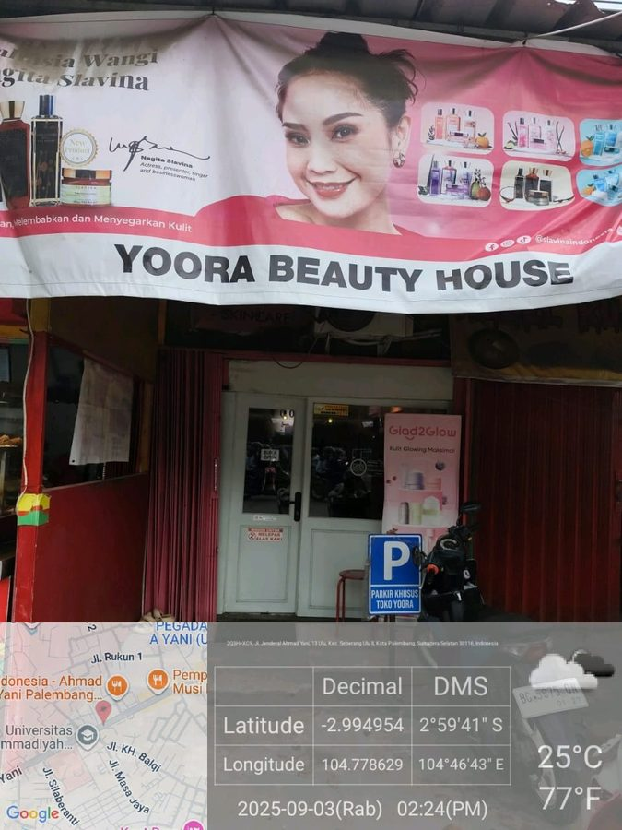
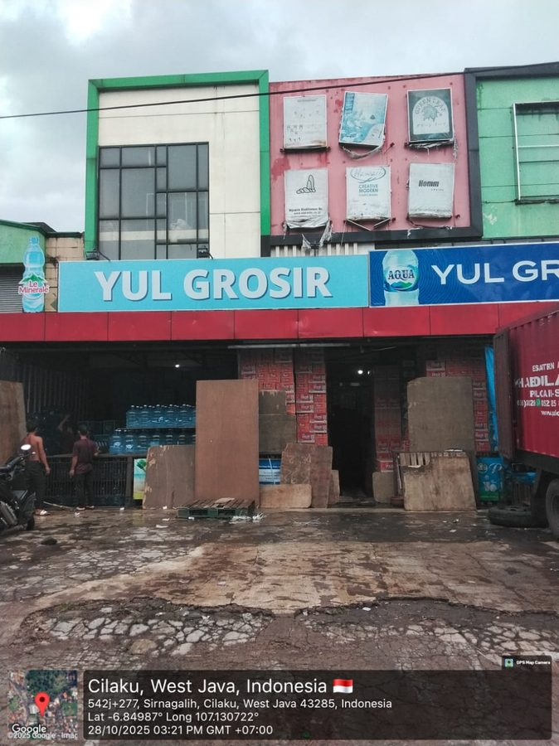
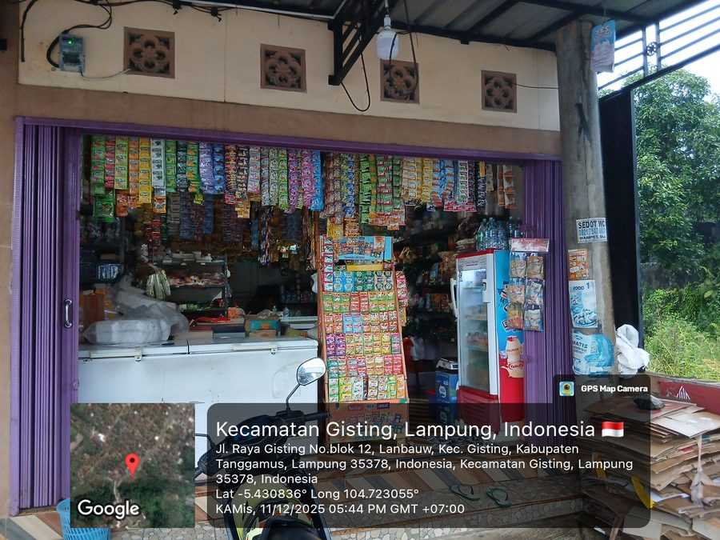
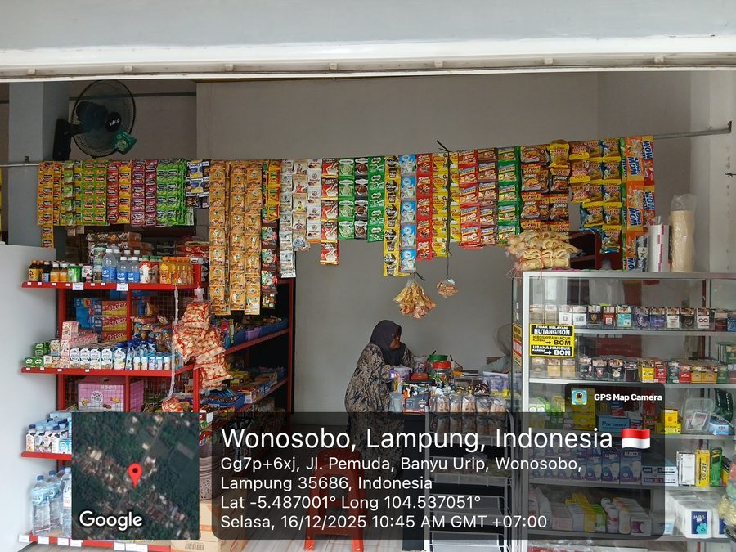

01 · BUSINESS USE CASE
Image Examples — and a Non-Negotiable Rule
Palembang, Indonesia
Cilaku, West Java
Gisting, Lampung
Wonosobo, Lampung
✕ Not Shop
✕ Not Shop
✓ Shop
✓ Shop
Business Rule: Geotag or It Doesn’t Count
● Every outlet photo must carry a geotag — no exceptions.
● A photo that looks like a shop but has no geotag is still classified Not Shop.
● Geolocation is extracted directly from the shop image itself, not entered separately.
Notes:
~2 min. Point out that the geotag overlay is baked into the pixels, not EXIF metadata — that is why extraction has to read it off the image (OCR), matching the Geo-Verify tool shown later in the scaled architecture. The two Not Shop examples are still real outlets — the point is the rule, not that they look fake.

Slide 8






02 · ARCHITECTURE
An Event-Driven Pipeline, End to End
Upload
Blob Storage
Event Grid
Function App
Vision Classify
Store Result
Field app
Azure Storage
Storage subscription
Serverless compute
Mistral Medium 2505
Cosmos DB
An Event Grid subscription on the storage account triggers the Function — nothing runs unless there’s an image to process.
Notes:
~3 min. Walk left to right along the diagram. The Storage account has an Event Grid subscription (System Topic on Microsoft.Storage.StorageAccounts) that fires the Function on blob creation. Call out that the Vision Classify step (teal, Mistral Medium 2505 on Azure AI Foundry) is the only AI-specific stage — everything else is standard Azure plumbing.

Slide 9





02 · ARCHITECTURE
Five Steps From Photo to Insight
1
2
3
Upload & Ingest
Event Trigger
Pre-Checks
The field app uploads the outlet photo straight to Azure Blob Storage.
An Event Grid subscription on the storage account fires the moment the blob lands — no polling.
The function validates image quality and DPI before spending a model call on it.
4
5
Vision Classification
Persist the Result
Mistral Medium 2505 scores the photo as Shop or Not-Shop with a confidence value.
Classification, confidence, and metadata are written to Cosmos DB against the outlet record.
Notes:
~3 min. Expand on each of the five steps — this is the technical meat of the architecture section. Step 2 is the Event Grid subscription shown in the portal screenshot; step 4 is Mistral Medium 2505, deployed via Azure AI Foundry (Global Standard).

Slide 10

03 · LIVE DEMO
What We’ll Walk Through
1
Drop a photo into Blob Storage
Upload a sample outlet photo, just like the field app would.
2
Watch the Function trigger fire
Live in the Azure Portal, the moment the Event Grid subscription fires.
3
See the vision model respond
Shop or Not-Shop, scored by Mistral Medium 2505 with a confidence value.
4
Confirm the record in Cosmos DB
Classification and metadata land against the outlet record.
Code: https://github.com/adilakshmivadavalli/drop_trigger_classify.git
Notes:
~5 min live (or ~2 min if playing the recording instead). Walk through the 4 steps as you go; invite the audience to suggest a tricky photo if doing it live.

Slide 11
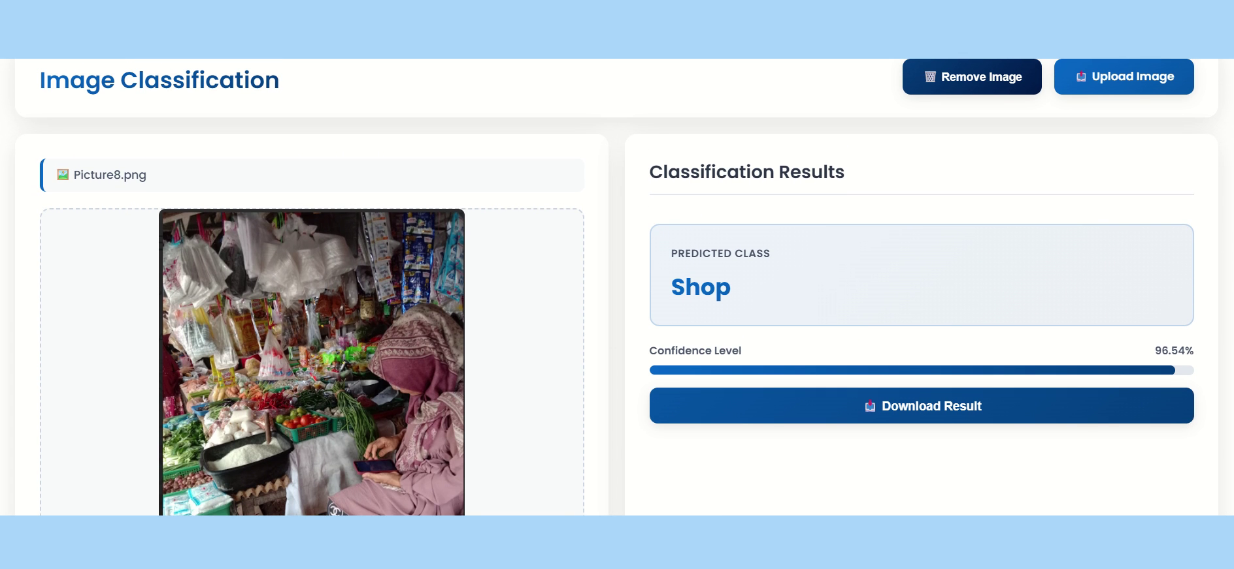
03 · LIVE DEMO
Recorded Walkthrough
An outlet photo goes in, a Shop / Not-Shop verdict comes out — in under a second.
Notes:
Click the video to play (~21 sec, silent) — a recorded run of the actual classifier tool: upload an outlet photo, hit Classify, and the Shop / Not-Shop verdict with confidence score appears. Use this as the fallback if the live demo isn’t possible on the day, or play it alongside narrating what’s happening on screen.

Slide 12




04 · SCALING & AGENTIC AI
What Breaks When Volume Grows 10–100×
Model Throughput Limits
One Function, One Job
No Path for Judgment Calls
Unpredictable Cost
Vision-model calls hit token and rate quotas under bursty load.
A single classify-and-store function turns into a monolith as more checks are added.
Low-confidence images still need a human, but there’s no structured hand-off.
Flat database throughput and unbounded model calls make spend hard to forecast.
Notes:
~2.5 min. Transition slide into scaling — these are real bottlenecks, not hypothetical ones. Sets up the 'why agentic' argument.

Slide 13



04 · SCALING & AGENTIC AI
Decoupling and Orchestrating for Scale
Quality
Classify
Geo-Verify
Blob Storage
Event Grid
Queue
Orchestrator Agent
Cosmos DB
Ingest
Storage subscription
Service Bus
Microsoft Agent Framework
+ change feed
if confidence is low
Human Review
exception queue
Resolved cases return to the same Cosmos DB store as everything else — nothing forks permanently out of the pipeline.
Notes:
~3.5 min. The core scaling diagram. Point out the queue for backpressure, the Orchestrator Agent box, and the human-in-the-loop branch for low-confidence cases.

Slide 14

04 · SCALING & AGENTIC AI
From a Single Model Call to an Orchestrated Agent
Today
With an Orchestrated Agent
● One function, one model call, one verdict
● No memory carried across steps
● No structured escalation when confidence is low
● A new check means rewriting the function
● An orchestrator reasons across multiple tools — quality, vision, geo
● State persists across steps: checkpoints, retries, resumes
● Low-confidence cases pause for a human, then resume automatically
● A new check is added as a tool, not a rewrite
Notes:
~2 min. Crisp before/after — use this to pivot from 'infrastructure scaling' to 'agentic redesign'.

Slide 15


04 · SCALING & AGENTIC AI
What to Plan for With Microsoft’s Agent Framework
Microsoft Agent Framework reached general availability in April 2026 as the successor to Semantic Kernel and AutoGen; agents can be hosted on Microsoft Foundry Agent Service.
Orchestration Model
Hosting & Runtime
Human-in-the-Loop
Graph-based workflows give sequential, concurrent, and hand-off patterns across your tools.
Microsoft Foundry Agent Service runs agents in a managed, sandboxed environment.
Built-in checkpointing pauses a workflow on low confidence and resumes after review.
Interoperability
Cost & Model Routing
Observability & Governance
A2A and MCP support let the agent expose or consume tools without one-off integrations.
Route easy cases to a lighter model; escalate only ambiguous images to a larger one.
Built-in tracing and agent-identity controls matter once autonomous steps touch production data.
Notes:
~3.5 min. Six things to plan for — don't read every bullet verbatim, pick 2-3 to go deeper on based on audience interest (orchestration model and human-in-the-loop tend to get the most questions).

Slide 16
Open for Q&A
Presentation title
Thank you!!
Notes:
Q&A — budget remaining time here. Thank the community and point to the LinkedIn QR code from the About Speaker slide if it comes up again.

